Slide 1
Taxonomizer: Interactive Construction of Fully Labeled Hierarchical Groupings from Attributes of Multivariate Data
Salman Mahmood, Klaus Mueller (Stony Brook University)

Slide 2
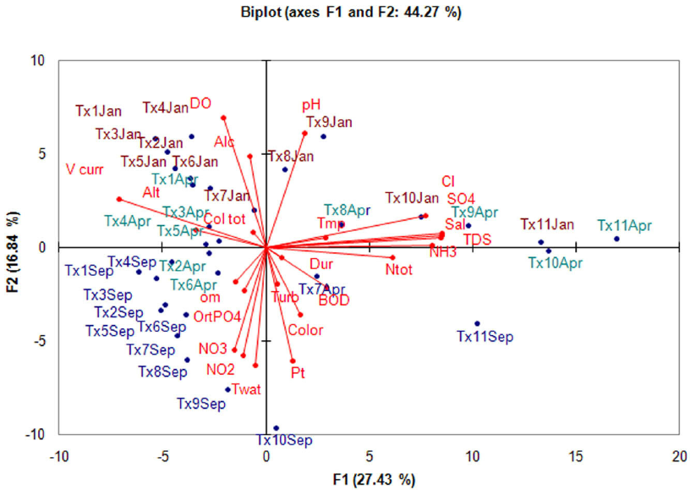
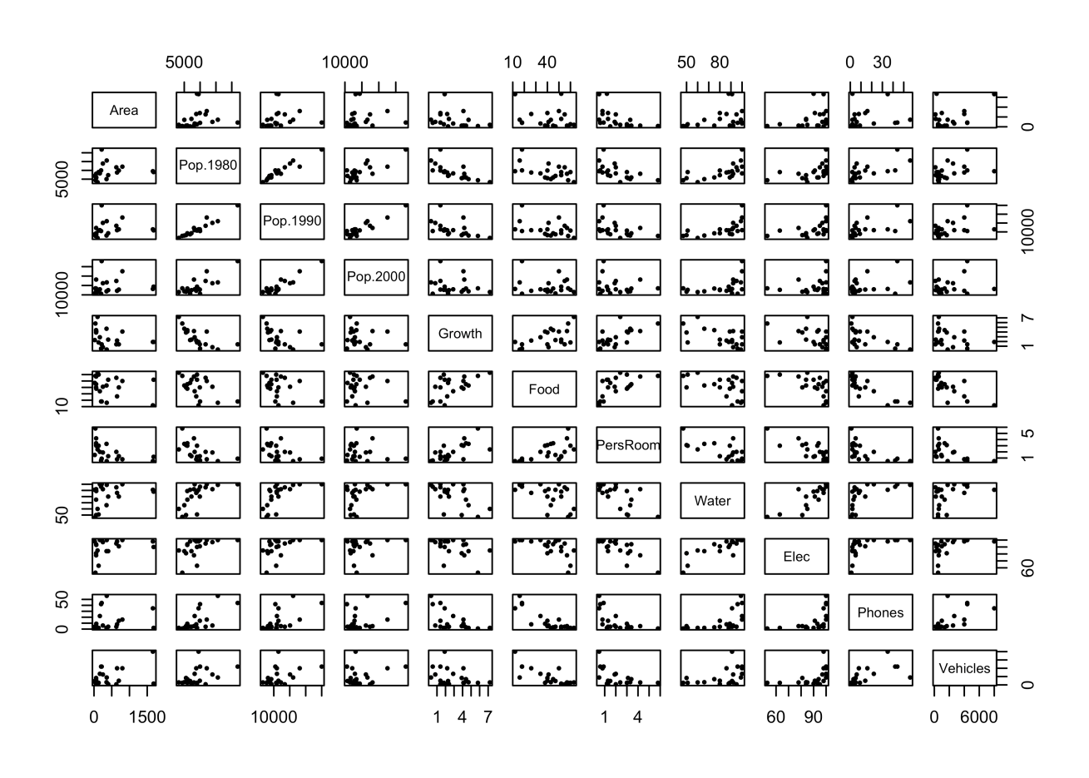
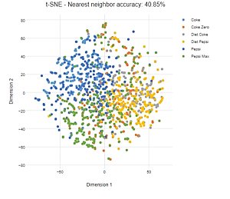
Let’s Get Started
Assume you are given a dataset with a dozen attributes
how are you going to visualize it?

Slide 3
Overwhelmed?
Too many attributes, too little time….
Let’s look at a practical example – a university dataset
US News score
academic rating
PhD student/faculty ratio
housing
town’s population
town’s average income
safety
transportation
location
nightlife
dining
weather
athletics

Slide 4
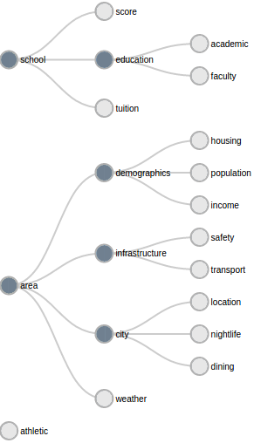
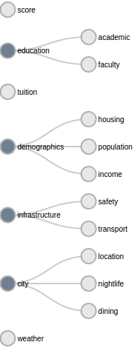
How Do You Think About Such a Data Space?

Slide 5
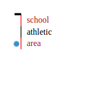
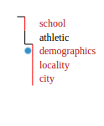
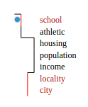
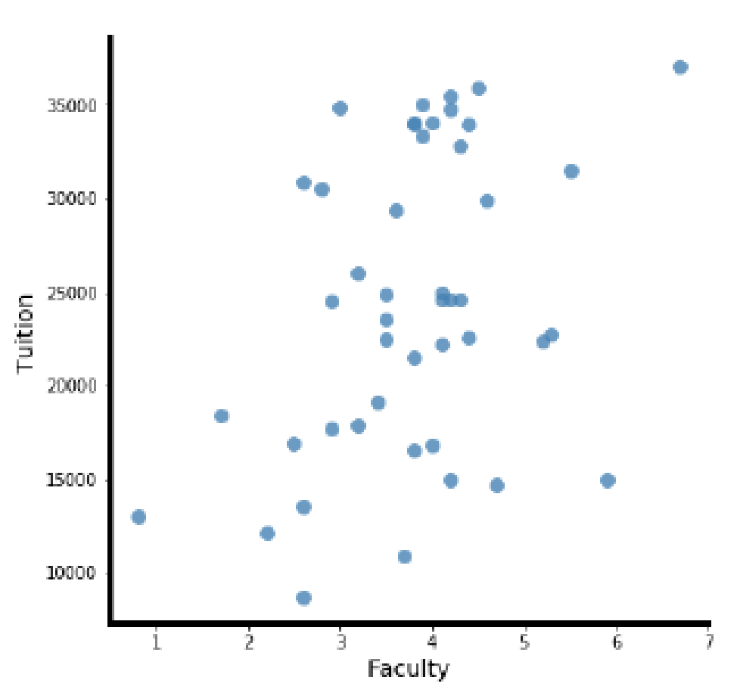
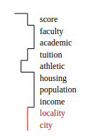
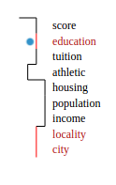
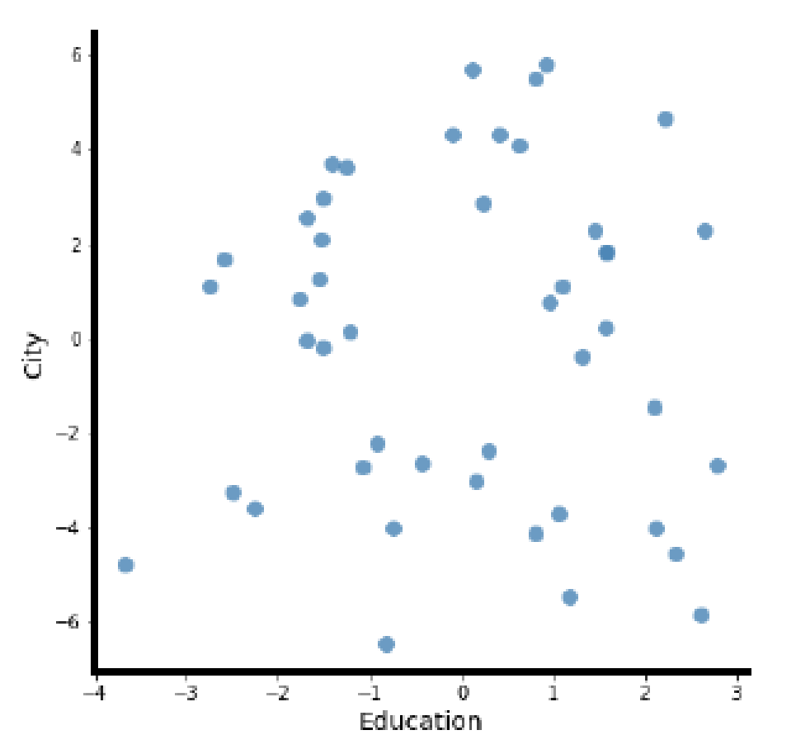
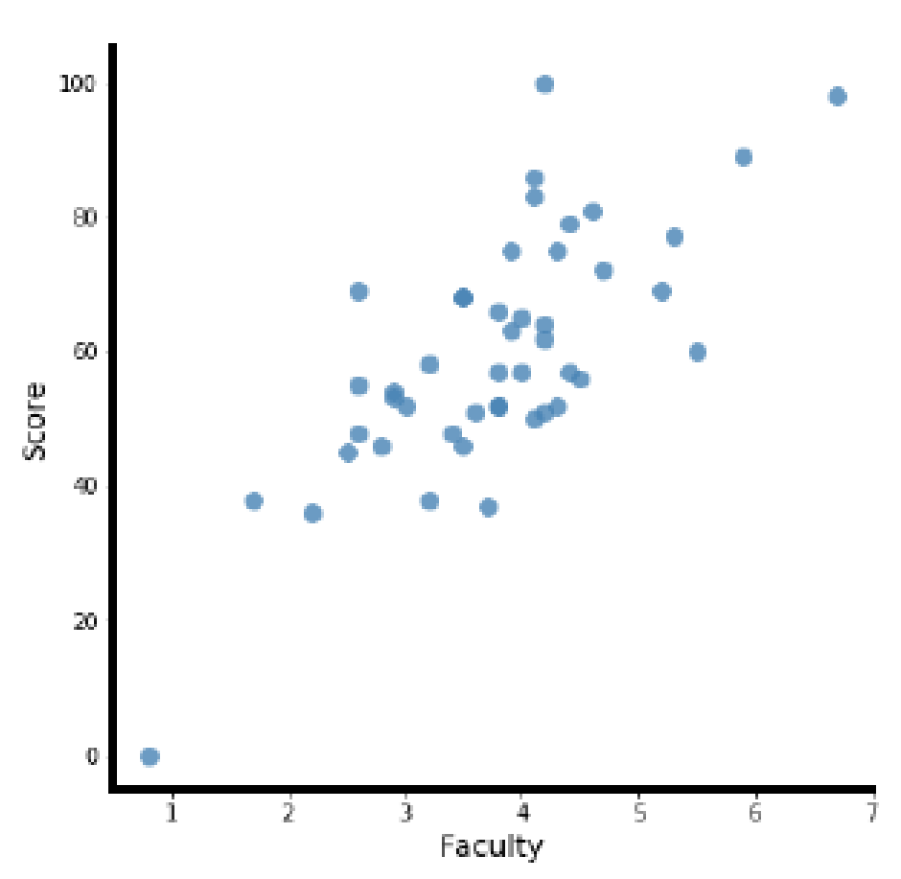
Would Enable Semantic Data Exploration

Slide 6
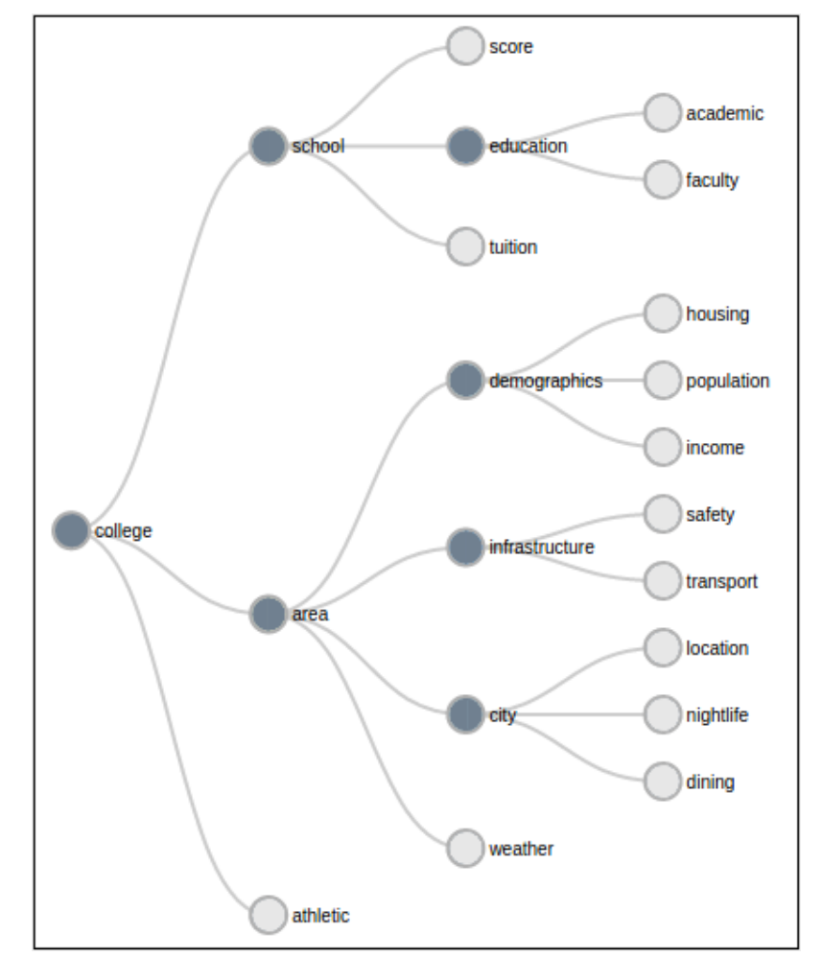
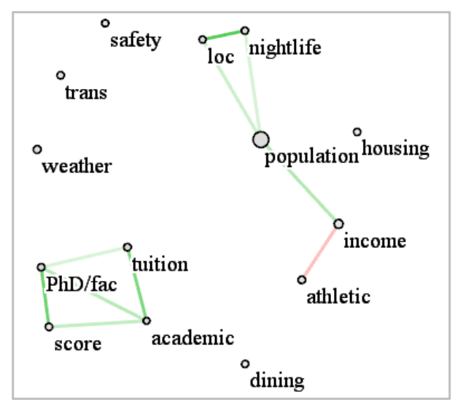
How To Construct Such a Hierarchy?
Correlation plot:
High correlation ≠ similar semantics ☹

Slide 7
Automatic Construction an Unsolved Problem
Problem:
determine a hypernym to a set of hyponyms
example: canine is hypernym to hyponyms {dog, wolf, coyote,…}
databases like WordNet are incomplete (semantic space is huge)
conflation of word sense is also a significant problem
example: bats = {animals, wooden objects often used in baseball}
Solution: get the human into the loop
visual analytics to the rescue
ours is such an approach

Slide 8
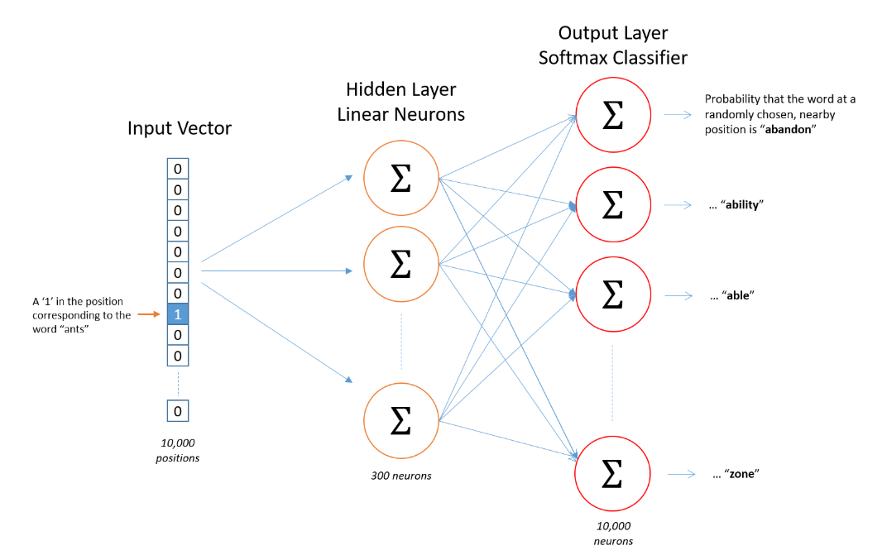
Our Approach
Use word embedding to encode the similarity of attributes
train a shallow NN with 10,000 unique words
probabilities in the output layer are given by the word contexts in the training dataset

Slide 9
Compute Semantic Attribute Similarity
Using the weight matrix
compute the distance of different words
build 10,000 x 10,000 distance matrix
lay out with MDS
only plot the attribute labels
To reduce conflation of word sense
use wordmover distance in conjunction with descriptive text for labels to compute the semantic attribute distance matrix

Slide 10
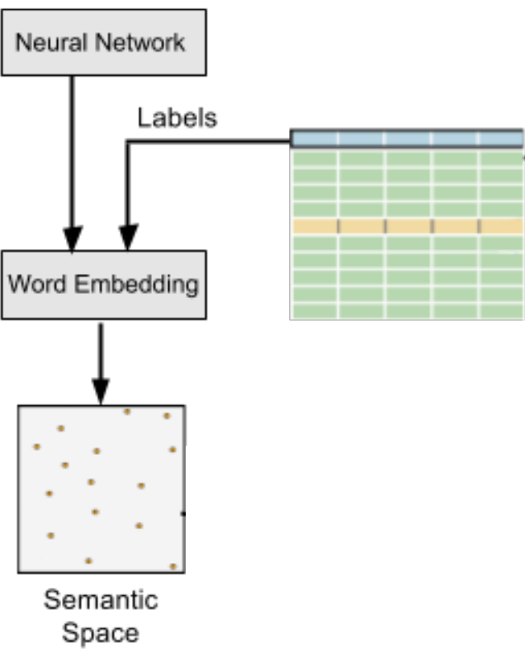
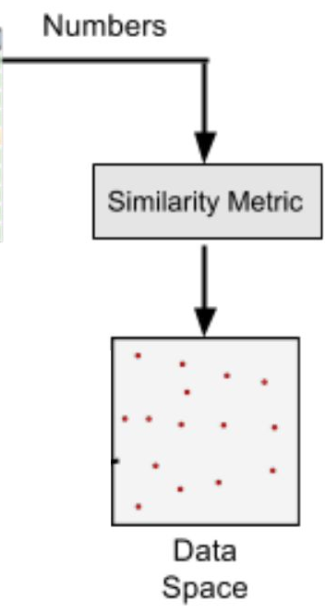
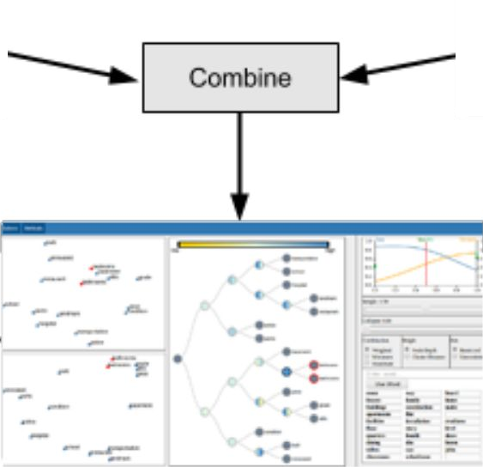
System Overview
Derive using degree of entailment:
the suggested broader term shares the textual uses of the narrower terms, e. g., person vs. boy

Slide 11
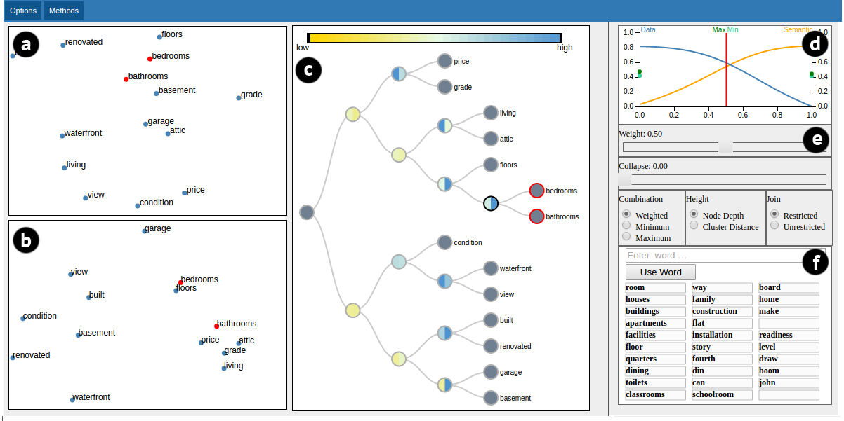
User Interface
Cophenetic correlation plot
Data space
Semantic space
compares the distance of two attributes n the layout and the dendrogram (gauges faithfulness)
cophenetic correlation

Slide 12
User Interface
Data space
Semantic space
Dunn Index of the covered terms in data space (left) and semantic space (right)

Slide 13
Let’s Label a Taxonomy

Slide 14
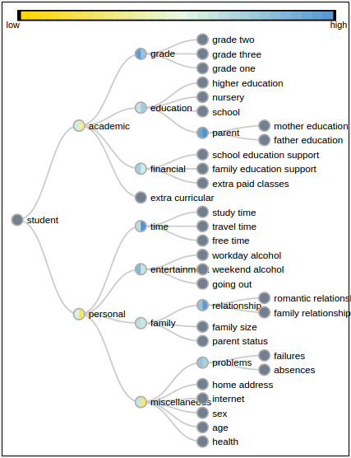
Scalability
Showed scalability for larger datasets
30 attributes and more
example: student performance dataset

Slide 15
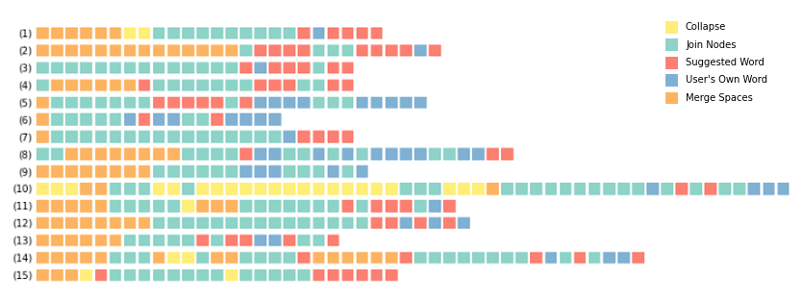
Evaluation
15 participants used our tool to label the university dataset
Comparison with manual labeling
labeled taxonomies were deeper (mean node depth 2.67 vs. 2.18)
labeled taxonomies were rated significantly higher by 15 other participants (rankings of 3 manual and 3 with our tool)

Slide 16
Questions?
Funding by NSF grant IIS 1527200

